Slide 1
Predict THE PROJECT

Slide 2
Problem statement:
KMAX a leading business company requires help to set up a new business in the preferred location.
Suggestion is required on which of the below three would prove to be more profitable
Restaurant
Shopping Mall
Resort with outdoor activities
They have selected the location to set up the business as Ringroad which is near the industrial area and has major IT companies near by and the huge population stays in this area

Slide 3
WHICH IS THE BEST ??
Restaurant
Shopping Mall
Resort with outdoor activities

Slide 4
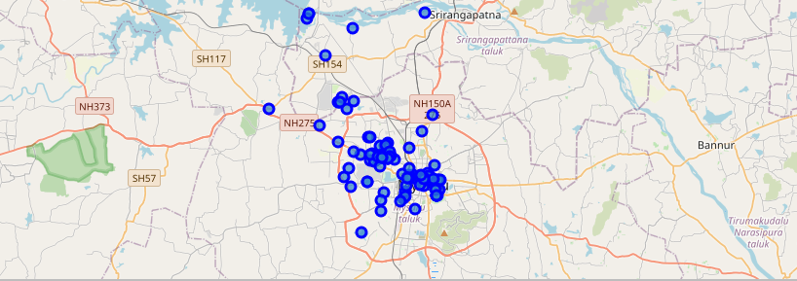
Near BY VeNUES

Slide 5
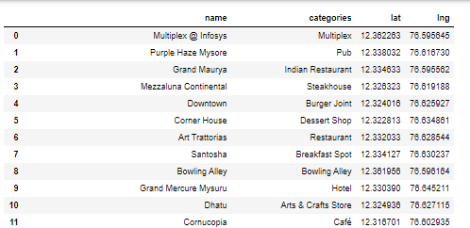
DATAFRAME

Slide 6
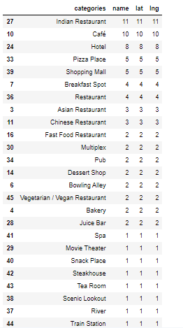
GROUPED AND SORTED DATAFRAME

Slide 7
THE BEST
Resort with outdoor activities

